Slide 1


Search Your Way to Success
Exploring Your Options, Preparing Your Future
Kate Millard| she/her/hers
Career Programming Coordinator
NAU Career Development
Notes:
Facilitator Notes:
Throughout these notes, text in italics represents instruction for the facilitator, while standard font represents speaker notes you can read to students.
Introduce the presentation and yourself (name, pronouns, position)

Slide 2
The Job Search

Slide 3
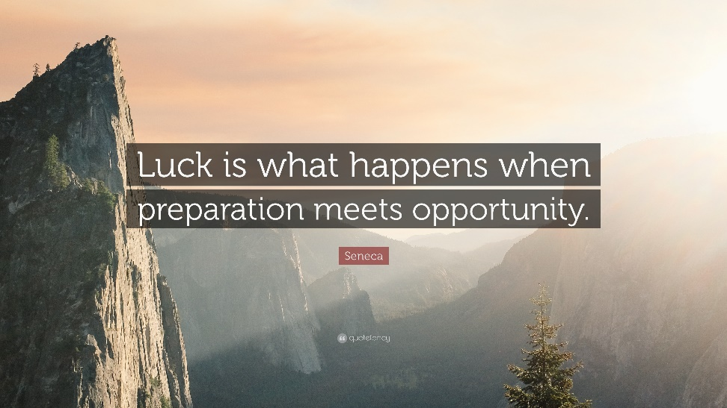
Your Degree Will Open Doors
Most degrees open doors to numerous industries and positions. With a degree in Climate Science & Solutions you could work in:
Greenhouse Gas Accounting and Verification
Sustainability Planning
Renewable Energy
Energy Policy
Conservation Efforts
Research
Education
Don’t be limited by lack of awareness. Your next job might be one that you have never considered, didn’t know existed, or didn’t know you were qualified for!
Notes:
Facilitator Notes:
Don’t be limited by a lack of awareness.
Research the full breadth of options available to you, so you can make an informed decision about the best fit for your professional interests, strengths, and values. Your next job might be one you’ve never considered, didn’t know existed, or didn’t know you qualified for!
Alternate for Degree path example:
With a degree in education you could work in:
training and development for a large corporation
international non-governmental organization working on literacy initiatives
in private, public, or boarding schools
summer camp
wilderness instructor for a therapeutic program
content creator for an educational media company
study abroad program leader or at an international school

Slide 4


Know Your Options
For a “big picture” view of many opportunities available to each major, use What Can I Do with This Major?
Select the box that most closely matches your degree.
Review the “Areas” to gather ideas for career paths and identify keywords from the “Employer” column that stand out to you.
You can use these keywords to refine your results in a job search engine.
Notes:
Facilitator Notes:
Nau.edu/career > WhatCanIDoWithThisMajor? Button on our homepage
Pull up this resource on the website and show them how to navigate it.

Slide 5
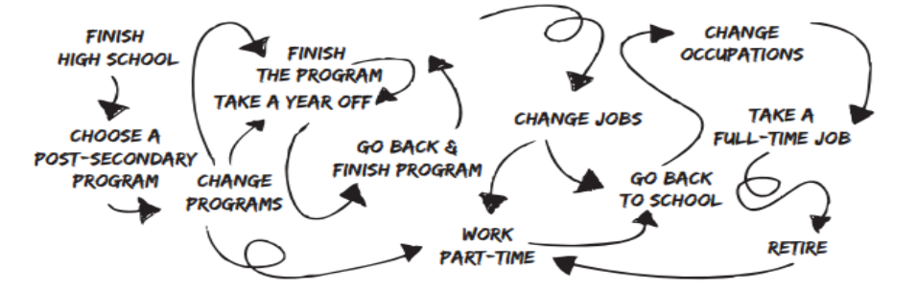
Keep Your Job Search in Perspective
Your first job out of college does not define your career.
Gen Z is 3x more likely to change jobs, 20% of them averaging 4 or more jobs over the short period of time they’ve been in the workforce, compared to Baby Boomers who average just 2 jobs in the past ten years. (LinkedIn)
75% of gen zers expressed interest in inhabiting numerous roles within a company. (Forbes)
When seeking new positions, look for opportunities that will challenge you and allow you to grow. Keep your strengths, interests, and needs in mind. Remember:
Career paths can rarely be planned out many years in advance.
Your career path will become clearer through learning and experience.
Notes:
Facilitator Notes:
When seeking a new position, look for an opportunity that will challenge you to grow professionally, build your network, and allow you to gain firsthand experience from which to compare your expectations with reality. From the self-awareness and knowledge you gain through each work experience, you’ll become increasingly skilled in identifying jobs that match your strengths, interest, and needs in each phase of your life.
As frustrating as it can seem, your career path can rarely be planned out on paper, many years in advance. Instead, your career path becomes clear as you walk it, learning more about yourself and your opportunities from experiences and relationships built along the road.
Think about how you can also build and use transferable skills.
If you are searching for an internship, this is where you will:
-Gain hands-on, real-life experience
-test out a career field or industry
-acclimate yourself to a professional setting
-find a new direction

Slide 6
Be Realistic: Finding a Job Takes Time
Finding a job takes time, energy, and resilience.
The amount of time for a job search varies depending on your needs and preferences. Stay optimistic and resilient throughout your job search by continuing to build your skills and experience.
During your search, you could:
Take a short class to develop a technical skill that will be useful in your field. LinkedIn Learning offers tutorials on most software programs.
Volunteer for an organization that’s related to the type of work you want to do.
Take a temporary position to gain experience and develop transferable skills in a professional setting.
Follow stories from your industry or field. Stay current on issues related to your field of choice by reading industry blogs, journals, or newsletters.
Network. Build your relationships with professionals in the fields that interest you.
It’s common to spend 6 months or more applying and interviewing before finding the right job.
Notes:
Facilitator Notes:
Be realistic: Finding a job takes time, energy, and resilience.
How long it takes to find a job depends on many factors, including your major, industry you want to work in, and location. Often, finding your first full-time position out of college is not an easy or fast process; It’s common to spend six months or more applying and interviewing before finding the right job.
During your search, you could:
• Take a short class to develop a technical skill that will be useful in your field. LinkedIn Learning offers tutorials on most software programs.
• Volunteer for an organization that’s related to the type of work you want to do. Your experiences can give you fresh stories to use in your interviews, and you might meet professionals who can encourage or advise you.
• Take a temporary position to gain experience and develop transferable skills in a professional setting.
• Follow stories from your industry or field. Stay current on issues related to your field of choice by reading industry blogs, journals, or newsletters. This information can be used to start conversations while networking or interviewing, to show you’re a serious candidate.
• Network. Build your relationships with professionals in the fields that interest you by accessing your weak ties , performing informational interviews, and researching on LinkedIn. These conversations can introduce you to strategies for getting your foot in the door, and opportunities that have not been publicized elsewhere.
For Internship:
Consider your motivation.
Search for leads.
Use your network.
Tailor your application materials.

Slide 7
Use Your Network
Throughout college, you’ve been developing a network that falls into two broad categories: strong ties, and weak ties.
Strong Ties
People you know well & are close to
Likely to share the same friend groups
Likely to use same information sources
Overlapping interests
Ex. Friend, Sibling
This part of your network is great for encouragement, however new opportunities don’t generally come through these relationships.
Weak Ties
People whose lives overlap slightly with yours
Likely to engage in different communities
Likely to know people you don’t know
Ex. Advisors, Friends’ parents, club members you don’t know well
It’s the people whose lives overlap just slightly with yours, who spend time in communities you’re not engaged in, with people you don’t know, who can open doors to new opportunities.
Reach out to your network of both strong and weak ties. Keep them updated on your job search, while asking them to send leads your way. Additionally, your network may be able to introduce you to professionals who you can reach out to for career conversations.
Notes:
Facilitator Notes:
Strong ties are people who know you well. You likely share the same groups of friends, gather information from the same sources, and have many overlapping interests. If you’re having a bad day, it’s probably a strong tie that you’ll lean on for support. Interestingly, although this part of your network is great for encouragement, new opportunities don’t generally come through these relationships.
Instead, it’s the people whose lives overlap just slightly with yours, who spend time in communities you’re not engaged in, with people you don’t know, who can open doors to new opportunities. These are your “weak ties.” Your parents’ friends, your friends’ parents, advisors, coworkers, and club members you haven’t spent much time with might fall into this category.
Reach out to your network of both strong and weak ties. Keep them updated on your job search, while asking them to send leads your way. Additionally, your network may be able to introduce you to professionals who you can reach out to for informational interviews or a career conversation.

Slide 8
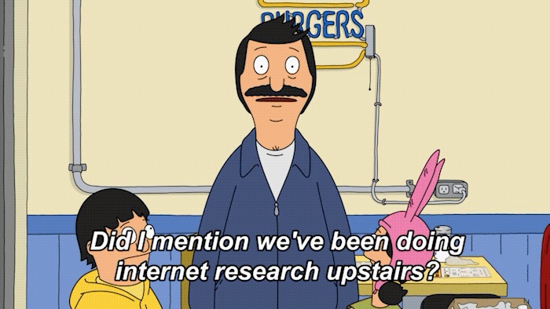
Do Your Research
As a job seeker, it’s important to be informed about the organizations you are applying to in order to help you decide if it could be a good fit.
Consider:
Work Culture
Employee Satisfaction
History
Challenges
Current Projects
Covid-19 Response
Additionally, this research will inform your application materials, allowing you to personalize your resume and cover letter to the specific organization and tailor your interview responses to their current issues and initiatives.
Notes:
Facilitator Notes:
Share the information provided but also talk about the importance of finding an organization/company that aligns with your vision/hope for a future work environment, team, and opportunity.

Slide 9

Make Sure Your LinkedIn is Updated
URL: www.linkedin.com
  Almost 500 million users from over 200 countries
  More than 40 million college students and recent graduates.
LinkedIn has a partnership with Google
  If you have a LinkedIn profile and someone “googles” you, your LinkedIn profile will appear in the top results.
93% of recruiters use LinkedIn to find employees
  70% of recruiters look at your social media.
Strengthen and extend your network
  Add your friends, classmates, family, employers, past presenters, etc.
Notes:
Facilitator Notes:
Share information provided and remind them that this is a networking platform that they can also apply for jobs on and be recruited through

Slide 10
LinkedIn Resources
There are several ways you can use LinkedIn to search for positions.
Use “The Student Job Hunting Handbook” as a guide to kick-start your career.
Use the LinkedIn students and recent graduates search engine to find jobs and internships.
Use the Alumni Finder to locate and network with NAU graduates who work with the organizations you're interested in, or who have jobs that interest you. NAU alumni make great candidates for information interviews.
LinkedIn is a networking site, members expect to hear from students who are researching career paths and opportunities. So, don't be shy! Learn how to communicate effectively on LinkedIn and reach out!
LinkedIn offers multiple learning modules relative to your skills, industry or career path. Take a Udemy class to build your transferable skills.
For additional resources on using LinkedIn, visit LinkedIn University. You can request to join the NAU Career LinkedIn group or learn more about using LinkedIn by reading SmartAxeGuide to Careers blog posts.
Notes:
Facilitator Notes:
Use “The Student Job Hunting Handbook” as a guide to kick-start your career. It is a series of guides broken up into specific sections for job searching.
Use the LinkedIn search engine to find jobs and internships using key words and appropriate filters.
Use the Alumni Finder to locate and network with NAU graduates who work with the organizations you're interested in, or who have jobs that interest you. NAU alumni make great candidates for information interviews.
LinkedIn is a networking site, members expect to hear from students who are researching career paths and opportunities. So, don't be shy! Learn how to communicate effectively on LinkedIn and reach out!
LinkedIn offers multiple learning modules relative to your skills, industry, or career path. Take a LinkedIn Learning class to build your transferable skills.
For additional resources on using LinkedIn, visit LinkedIn University. You can request to join the NAU Career LinkedIn group, or learn more about using LinkedIn by reading SmartAxeGuide to Careers blog posts.

Slide 11
Job Search Engines
Job sand industries. Narrow your search results by using keywords, such as job titles, field or industry, responsibilities, location, and “entry-level.”
Indeed.com Aggregate search engines locate and organize job openings. These search engines can be general or specialized to specific fields jobs found across the web
Idealist.org Non-profit and non-governmental organization jobs and internships
USAJobs.gov Positions within the federal government
Handshake Job search database accessible to NAU students and alumni
LinkedIn.com Used both by individual’s seeking employment, and organizations seeking candidates
TheMuse.com Beautifully designed website with positions across industries
Internships.com - Narrow your search to “entry level jobs” to find full-time positions
There are numerous field and population-specific search engines, such as VetCentral (jobs for veterans), HigherEdJobs (higher education jobs), CareerJet (international positions), and Poached (restaurant jobs).
To locate field or population-specific search engines, search online: Job Search Engine + your field or population of interest
Use WhatCanIDoWithThisMajor? to identify other field-specific search engines, located in the bottom right column of every major-specific page.
Notes:
Facilitator Notes:
There could be specific job boards out there for your industries (like the ones on WhatCanIDoWithThisMajor) but we have a few listed for you to explore.

Slide 12
Recruiting Agencies
Recruiting agencies act as an intermediary between organizations looking to employ someone and individuals looking for a job, sourcing candidates for the full-time or temporary job vacancies they’ve been asked to fill. Reputable recruiting agencies do not charge fees to the job-seeker, and often have in-depth information about the employers they work with to help you prepare for an interview. Some recruiting agencies require intake interviews and/or a reference check. Examples of recruiting agencies include:
Aerotek.com Nationwide jobs in multiple markets
StaffingFirst.net Healthcare positions in the Phoenix area
InFlightCrewConnections.com Aviation positions nationwide
For a list of award-winning staffing agencies, visit BestofStaffing.com
75% of gen zers expressed interest in inhabiting numerous roles within a company. (Forbes)
To locate field or location-specific recruiting agencies, search online: Recruiting Agencies + your field of interest, or location of interest.
Reputable agencies do not charge the job seeker for their services.
Notes:
Facilitator Notes:
Share information provided.

Slide 13
Temporary Staffing
“Temping” allows you to build your resume with professional, short-term jobs as you research and apply for career positions, while exploring industries and job functions. Some positions are “temporary to hire” based on performance, allowing the organization to learn about your work style before formally offering a position, and allowing you to experience the company firsthand before committing to a long-term role. Many temp agencies are local, or regional branches of a national chain. Examples of temping agencies include:
Hotfoot Recruiters
KellyServices.com
Performance Staffing
To locate a temping agencies in your area, search online: Temporary Staffing + your city.
Reputable agencies do not charge the job seeker for their services.
Notes:
Facilitator Notes:
Share information provided.

Slide 14
Professional Associations
Connect with individuals from industries or very specific fields.
These associations advance the interest of the professions they represent by hosting conferences, publishing journals, establishing and promoting best practices, credentialing members, and advocating for policy at a national level.
Get informed about:
internal job boards
continuing education through webinars and trainings
networking events
mentoring programs
Frequently, they waive or reduce membership and conference fees for students and recent grads. Participating in a professional association can expose you to the realities of working in that field, and help you develop a professional presence.
To locate professional associations:
WhatCanIDoWithThisMajor? lists professional associations on the bottom of each major-specific page.
Use Linkedin Group search
Online Search: Professional Association + your field of interest
Notes:
Facilitator Notes:
For example, the American Society of Hematology includes over 15,000 members whose careers involve the research, care, education, or advocacy of blood diseases, while the International Parking Institute has a much smaller membership focused on transportation flow, land use for parking, and parking law enforcement.

Slide 15

Corporate and Organization Websites
Visit the employment webpage of organizations that interest you to learn about job openings. Sometimes, jobs will post to the organization website before being picked up by a job aggregator (like Indeed.com).
Frequently, organizations will also share information about benefits online, allowing you to compare the full package of salary and benefits across employers who interest you.
Notes:
Facilitator Notes:
Not all opportunities are going to be listed on various job boards so if there is an organization that you are interested in, see if they have a Careers or Internships page. If they do not, you could also reach out to them via email or cold calling to see if there might be any opportunities on the horizon.

Slide 16
Career Fairs
To connect with recruiters and learn about organizations, attend both on- and off-campus career fairs. Demonstrate that you’re a serious candidate by dressing professionally, bringing copies of your resume, and introducing yourself to recruiters with your elevator pitch (A 30-second introduction about you, your interests, and what you want to do.) Collect recruiters’ business cards from the organizations that interest you and follow up with an email expressing your desire to learn more about opportunities they offer.
NAU hosts several departmental career fairs every semester as well as a general career fair and participates in the Arizona Career Mixer in Phoenix in partnership with ASU and UofA. Check Handshake for dates for upcoming events and fairs. Additional career fairs include:
NationalCareerFairs.com: Nationwide career fairs
HireLive.com: Hosts career fairs across the country specializing in sales, retail, and management positions
Goodprospects.goodwill.org: Nationwide career fairs hosted by Goodwill
Goodwill AZ: Hiring events in Arizona hosted by Goodwill
To locate career fairs, search online: Career fair + location or industry
Notes:
Facilitator Notes:
You can plug the Career and Graduate School Expo if you’d like but also talk about the variety that is out there based on a quick google search

Slide 17
Social Media
With increasing frequency, social media is being used by employers to recruit, verify, and screen candidates. Review your online profiles with an employer’s eye, removing photos and posts which might cast suspicion on your ability to act or communicate professionally, or represent an employer in a positive way.
In many jobs requiring interaction with the public, employers know that their clients will be googling the names of their employees, to find out if the company representative is someone they can trust. Therefore, it’s in the organizations best interest to make sure your online presence reflects positively on their brand before offering you a position.
When using Facebook and Twitter in your job search:
Inform and update your network about your search, encouraging them to send you leads
“Like” or follow organizations that interest you professionally, and comment on their updates
Share or retweet information that supports your personal brand
Post about your job search activities
Ensure that your profiles are up-to-date with your most recent accomplishments
“Hide” news from friends who post unprofessional content
When not using Facebook in your job search:
Set your privacy settings to “friends only,” and do not allow friends to tag you in photos
Notes:
Facilitator Notes:
Share information provided specifically the second paragraph about future clients/customers/stakeholders googling employees

Slide 18
Job Search Centers
You can access training, resources and leads through job search centers in your community. Some job search centers include:
CareerOneStop.org: Sponsored by the U.S. Department of Labor, these career centers are located across the United States, offering training and resources for finding a job, skill and interest assessments, 1-on-1 career advising and group classes. Additionally, they host a robust website with tools and resources.
Goodwill Industries.org: This non-profit organization offers advising from career coaches, training in job search skills, resume development, and interviewing. Locate a branch near you through the website.
Coconino County Career Center: Locally-based job centers can offer connections and training in touch with the needs of community employers. Some centers, including this one, can potentially offer funding through the Workforce Investment Act.
Notes:
Facilitator Notes:
Depending on their field, this could be helpful or might not be.

Slide 19
Take in the Whole Picture
Getting a job offer is exciting. There are many factors that go into evaluating a job offer holistically to make sure that it matches with your interests, strengths, and values. Before accepting a position consider these questions.
What benefits are included?
There are times when people will choose a lower salary for benefits that better fit their needs and values. Be sure to include vacation time, relocation assistance, development programs, loan and/or tuition reimbursement, stock options, health insurance, and retirement plans in your decision-making. Throughout the hiring process, it is important to Understand Total Compensation
Can you expect to grow in this job? Is the pathway to promotions, or other positions within the organization, clear? What type of training and professional development is offered? Will you receive regular feedback and/or performance reviews, to develop your skills?
How stable is the organization, and industry it represents? Is a change in management likely, or major litigation which might impact your role or position? Does the organization have a reputation for adapting to changes in the market or new technology? Is the industry growing, or declining?
Negotiating an offer may be acceptable, depending on the organization
Notes:
Facilitator Notes:
Total compensation is a Career Step module available on Udemy

Slide 20

Negotiating and Accepting an Offer
If you are offered a position while pursuing multiple opportunities, you can let the other organizations know you have received an alternate offer yet are still very interested in their organization. You can ask when they expect to make a hiring decision. This gives them the chance to accommodate your deadline if they are seriously considering you as a candidate. You can ask the organization offering you the position for time to consider; generally, up to one week is acceptable.
Once you accept an offer, it is not professional to back out if another offer presents itself, so make sure you are fully committed. Contact other organizations you have been communicating with and politely decline their offers or withdraw your application from consideration.
Developing skills for negotiating and accepting an offer take time to develop, start now
Notes:
Facilitator Notes:
Ask to clarify about acceptable time period to consider offer.
Negotiating and accepting an offer > we have a Career Step for that on Udemy as well.

Slide 21
For a Successful Job Search, Remember to:
Tailor your application materials to the job description, including both the resume and cover letter.
Follow up interviews with thank you emails or letters.
Create a file of jobs you’ve applied to, keeping electronic or paper copies of the job descriptions, so you can prepare for the interview if selected. (If hired, keeping a copy of the job description will allow you to evaluate that you are meeting the goals and objectives of the position.)
Polish your interview skills by taking an Interview Workshop completing Career Step Module or scheduling a mock interview with NAU Career Development.
Polish your resume by taking a Resume Workshop, participating in drop-in resume review hours next Spring, or scheduling a 1-on-1 resume review appointment at NAU Career Development.
Notes:
Facilitator Notes:
Share basic reminders + any tips that you would recommend from your own experiences!

Slide 22
Resumes

Slide 23





The Main Parts of a Resume
Header: Your name and contact information
Summary of Qualifications/Skills Summary
Education/Previous Institutions/Degrees
Experience: Work experience & other experiences
Additional Sections: To help you stand out

Slide 24
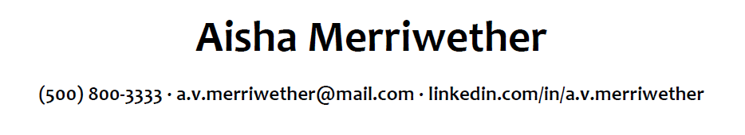
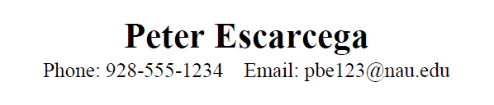
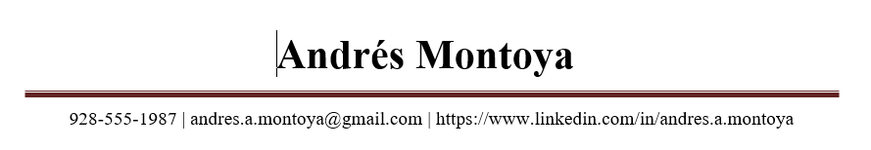
Header: Contact Information
What to Include:
Name and/or Preferred Name
Phone Number
Email Address
LinkedIn URL
What Not to Include:
Date of Birth/Age
Address/Residence
Race/Ethnicity
Nationality
Notes:
What to include: name and/or preferred name, phone number, email address, linkedin url (only if it is updated and ready to go)
What not to include: date of birth/age, address/residence, race/ethnicity, nationality. If you are searching locally, it is ok to have you city and state so they know you are close by. This play on a potential positive unconscious reaction whereas if you put a different state they could consciously or unconsciously count you out for the role because you might have to move, not start at their preferred time, etc.

Slide 25
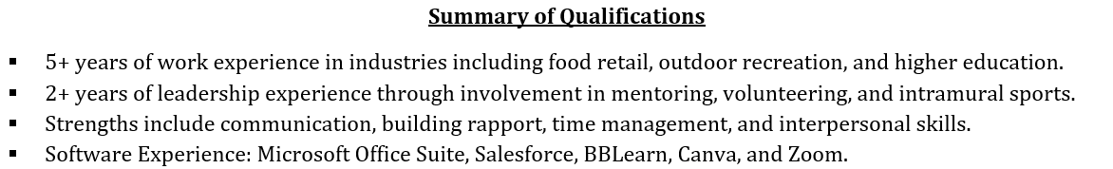
Summary of Qualifications
What to Include:
3-5 bullet points that highlights them as the best candidate for the role
  These are targeted or specific to the experience they are applying for
  Look at the minimum and preferred qualifications sections on the job description and make sure those are reflected in this section
What Not to Include:
Objective or paragraph summary of their experience

Slide 26
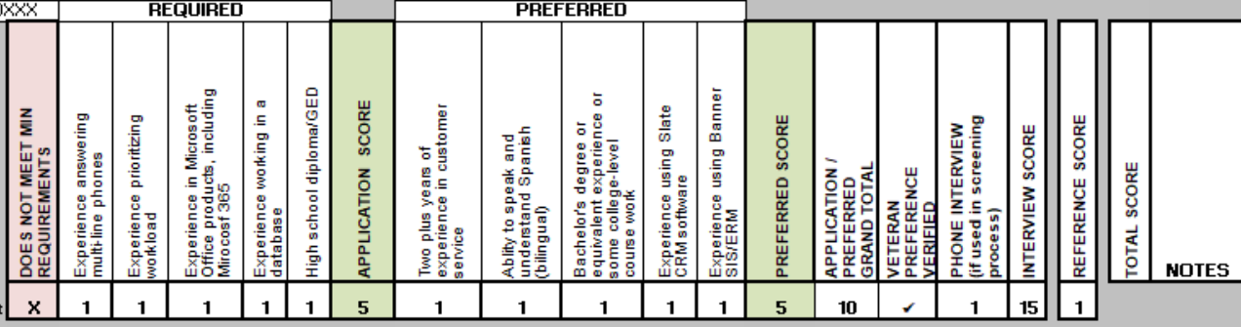
The Hiring Matrix

Slide 27

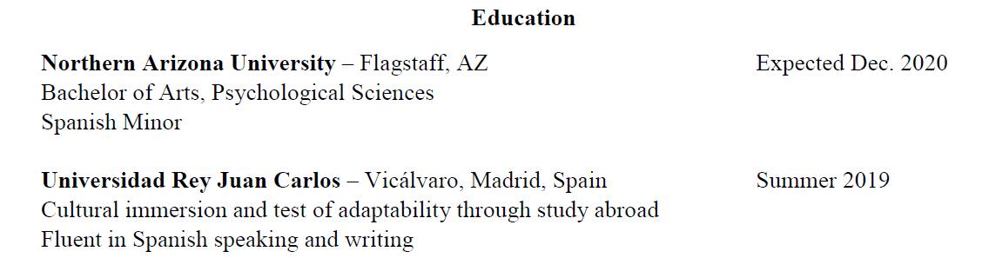

Education
What to Include:
Name of Institution, Location
                We recommend only including college & beyond
                If you have technical school that aligns with their current degree or future goals, include it
Degree: Type, Major, Minor
Month & Year Completed
Scholarships
GPAs

Slide 28
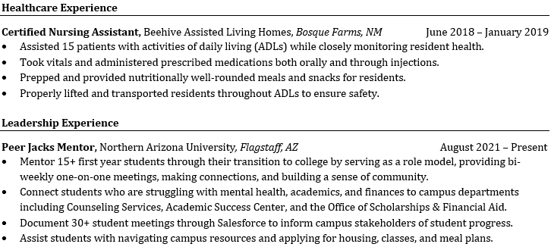
Experience
Helpful Tips for Resume Experience: Instead of Work Experience, they can breakdown your experiences.
Relevant Experience
Leadership Experience
Medical Experience
Lab Experience
Internship Experience
International Experience
Additional Work Experience
When they breakdown their experience, they show employers how diverse their experiences are.

Slide 29
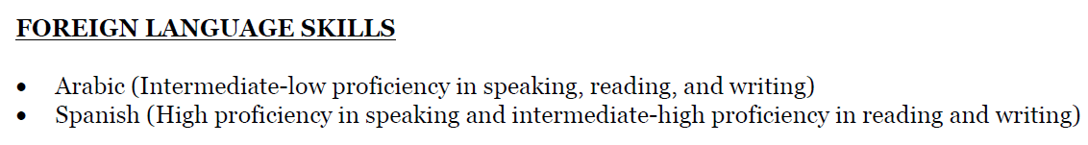
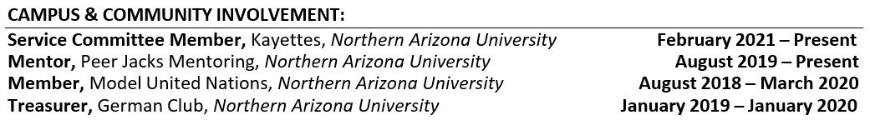
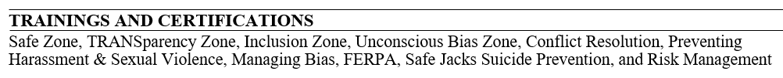
Other Things to Include on a Resume
Below are examples of sections to add:
Software Experience
Language Competencies
Campus & Community Involvement
Professional Affiliations
Certifications & Trainings
Technical Skills
Lab Techniques
Transferable Skills
Honors & Awards
Presentations & Conferences

Slide 30
Fonts & Formatting

Slide 31
Fonts
Be consistent across all resume sections (header, content, etc.)
Choose a font with serifs, such a Cambria, Book Antiqua, or Times New Roman
Use bold to highlight important information, such as the title of your degree or positions you’ve held
Use black text only, and color (if any) sparingly
Make sure your font is readable, usually at least 10pt but this depends on the font

Slide 32
Formatting
Align key information along the right and left margins to make the resume easy to scan and digest
Use bullet points, rather than paragraphs, to describe your experience
Edit for extra spaces and indentations, dangling bullet points, and consistent use of periods
Be consistent in your format: 5/2021 or May 2021? Punctuation
Consider including horizontal lines to distinguish each section and/or add a border.

Slide 33
Accomplishment Statements

Slide 34
Writing Accomplishment Statements
Action Verb (WHAT):
  Check out our Action Verbs sheet to help you get started crafting articulate and focused bullet points.
    Created art-based lessons…
Specify/Quantify (HOW):
  Quantifying and specifying your experience answers the “how” questions – how many, how long, how much, etc.
    Created a 3-week unit of art-based lessons for 25 first graders…
Result/Outcome (WHY):
  The results and outcomes help make a clear connection between your experiences and your career profile/application.
    Created a 3-week unit of art-based lessons for 25 first graders to introduce the different art mediums and to build their confidence utilizing art materials
Notes:
Writing accomplishment statements, or your bullet points is extremely important. Start with an action verb. If you need help, we have a 3-4 page document with a ton of action verbs that you can look at by googling nau action verbs.
Then go on to quantify and specify your experience so you are able to show how you’ve gained your skills. This also helps answer those how questions like: how many, how long, how much, etc.
If you are able to, make sure that it is clear why you were doing something or what the impact/result was.

Slide 35
Cover Letters

Slide 36
What Do You Remember About Resumes?
Notes:
https://create.kahoot.it/details/31254a48-e293-41b8-a405-f8cdffd9d380
Kahoot.com > jis57@nau.edu > PW=normal one

Slide 37
The Main Parts of a Cover Letter
Header: Your name and contact information
Date of submission and employer information
Greeting and intro paragraph tips/first impressions
Content: What to include and how to help develop it further
Concluding paragraph, salutation, and signature

Slide 38
A Well-Crafted Cover Letter:
Makes a powerful, emotional connection with the reader
Demonstrates your genuine interest in and understanding of the organization
Differentiates you from the competition by modeling your:
  clarity of purpose
  writing ability
  understanding of professionalism
Can get you an interview!
Notes:
Well-written cover letters can distinguish you from a pile of applicants, many of whom send generic cover letters or no cover letter at all.
A customized, professional cover letter can make you stand out from the crowd, get members of the hiring committee talking about you, and inspire the reader to want to meet you in person.

Slide 39
Dear Sir or Madam:
I’m writing in response to your job posting for a 3rd Grade Teacher. I believe I have the skills, qualifications, and motivation to succeed in this position. I have enclosed my resume for your review and look forward to being considered for this position.
Dear Ms. Oswald:
I was pleased to learn of the 3rd Grade Teaching position at Flagstaff Elementary School and I would like to convey my sincere interest in joining your education team. As a Flagstaff resident, I have experienced firsthand the importance of the Flagstaff School district and how the education they provide supports the youth of the communities in the northern Arizona region. I would be honored to offer my educational knowledge and technical skills to a district that places great value on meeting students’ needs, exceeding their expectations, and providing a high quality of education.
Notes:
Activity Instructions:
Please take a minute to read these introductory paragraphs from two different cover letters to yourself. Which one do you think is stronger? What significant differences do you notice between them?
After the students have read the examples, ask for a volunteer or two to share their answers. Note that the first example is generic, and is focused solely on the writer, while the second example is personalized and demonstrates an understanding of the organization being applied to.

Slide 40
Tip #1: Personalize
Address the cover letter to the individual responsible for hiring
In the first paragraph, demonstrate your knowledge of the organization and why you’re so excited to join them
  What is something you like about the organization or what makes them stand out to you as a candidate?
  What recent accomplishments has the organization made? Have they been in the news? Do you use their products or services?
  What draws you to apply there? (Be sure you checked out their website)
  How can you be of value to their mission, vision, and goals?
Notes:
Cover letters are your golden opportunity to differentiate yourself from other candidates, standing out to potential employers for your enthusiasm, understanding of the organization, and professional communication.
Many applicants miss out on this opportunity and send a generic cover letter instead, something that reads like it could have been sent to numerous employers. These are horrifically boring to read, and don’t add much value to your application.
The numbered talking points below relate to the numbered bullet points on the slide:
1) Address the cover letter to the hiring manager. You can do this by finding out who is doing the hiring or chairing the hiring committee, calling the HR department to ask. Address the letter to this individual.
2) Demonstrate your knowledge of the organization and why you’re so excited to join them. Average cover letters describe how your skills and experience match the requirements of the position; excellent ones demonstrate your knowledge of the organization and why you’re so excited to join them. This paragraph isn’t primarily about you; it’s primarily about them, and secondarily how you can add value to their mission or goals.

Slide 41
I am very adaptable to new environments and situations and enjoy the challenge of working with a diverse team to accomplish common goals. Being outside of my comfort zone and finding creative ways to communicate across cultures is a skillset I am competent in, which make me a qualified candidate for the Travel Abroad Instructor Assistant position with the JetCorps program.
Living with a host family in rural Botswana for twelve weeks challenged me to adapt to an unfamiliar situation. While there, I led a team of four international volunteers to assist a local women’s organization in remodeling a preschool. This first-hand experience taught me the patience necessary for communicating with a diverse team to achieve a common goal. Due to our combined efforts, the preschool is now equipped to serve 85 children. As a Jet Corps Instructional Assistant, this experience will allow me to relate to students who are traveling abroad for the first time, helping them adjust to and work within a new culture.
Notes:
Activity Instructions:
Please take a minute to read these examples of body paragraphs to yourself. Which one do you think is stronger? What significant differences do you notice between them?
After the students have read the examples, ask for a volunteer or two to share their answers. Note that the first example makes claims without giving any proof or evidence of having mastered the skill, while the second example gives specific examples of how the writer modeled the competency in a real-life setting. In the second example, the writer explains how their skills will help them be successful in the position.

Slide 42
Tip #2: Include Undeniable Proof
Back up claims about your strengths, talents, and experience with specific examples. Show, don’t tell
Relate your experience to the job description
If the job you are applying for does not directly relate to your experience, include specific examples of transferable skills
The resume gives the “big picture,” so your cover letter can focus on a few experiences in depth
Notes:
The cover letter gives you an opportunity to build on the concrete experience which you indicated in your resume.
Generally, cover letters include 2-3 paragraphs highlighting the relevant skills or experiences that make you stand out.
The numbered talking points below relate to the numbered bullet points on the slide:
Back up claims about your strengths, talents and experience with specific examples. Just like in the resume, you’ll
want to back up your claims with “undeniable proof” to show that you have relevant experience on which to base your claims, and the outcomes of your efforts. Show your experience by illustrating your claims with specific examples, instead of just telling the reader that you have experience.
2) Relate your experience to the job description
3) Emphasize transferable skills. Be sure that your cover letter focuses on the skills that the employer is hiring for. If you’re applying for a position in a field you don’t have experience in, focus on how you’ve applied the skills to be successful in it in other environments.
4) The resume gives the “big picture,” so your cover letter can focuses on a few experiences in depth. Your cover letter does not need to summarize all of your experiences, or even include a reference to each one. Rather, identify the skillsets and experience that are most important to the employer, based on the job description. Choose a few that you know you shine in, and focus on these skills in depth. Tailor your vocabulary to match the job description.

Slide 43
Tip #3: Stick to the Format
A cover letter is a formal document
Use a colon after the greeting
  Dear Mr. Thompson:
In the absence of a personal contact, use a formal generic address (e.g., Selection Committee, Hiring Professionals, Hiring Manager)
Use a formal business letter format and your resume header
Notes:
Cover letters demonstrate your understanding of professionalism, so it’s important to stick to the format that’s accepted in the professional community.
(Visual examples follow on the next slides)

Slide 44
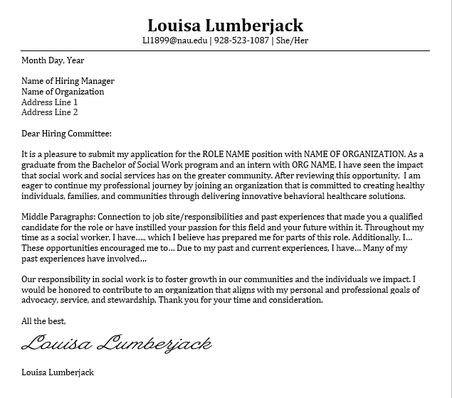
Header
Introductory (Purpose) Paragraph
2-3 Short Body Paragraphs
Closing Paragraph
Signature and Typed Name

Slide 45

Key Cover Letter Things to Remember
We recommend having at least 3 paragraphs:
  Paragraph 1: Why are you writing this letter and how did you hear about this job?
  Paragraph 2: What is special about you? How are you right for the company/role?
  Paragraph 3: Refers to attached documents and/or follow-up
Pay close attention to your grammar, punctuation, and spelling
Look on the page: alignment, spacing, proper business format
Notes:
Key things to remember:
We recommend having at least 3 paragraphs:
Paragraph 1: Why are you writing this letter and how did you hear about this job?
Paragraph 2: What is special about you? How are you right for the company/role?
Paragraph 3: Refers to attached documents and/or follow-up
Pay close attention to your grammar, punctuation, and spelling
Look on the page: alignment, spacing, proper business format

Slide 46
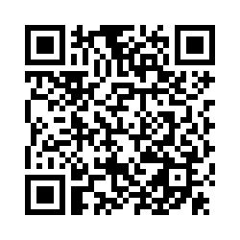
We Want to Hear From You!
Notes:
Facilitator Notes:

