Slide 1

The W.A. Franke College of Business
Presents
Financial Wisdom for
Life after Graduation
Professor Kevin Aguas

Slide 2
Today’s Presentation
Bits of Financial Wisdom
    Professor Aguas Career Life Experiences
    Considering your Budgeting Cash Flow
    Student Loan Debt
    Employer Benefits
    Credit Card Debt
    Trade-offs – Financial Wisdom

Slide 3

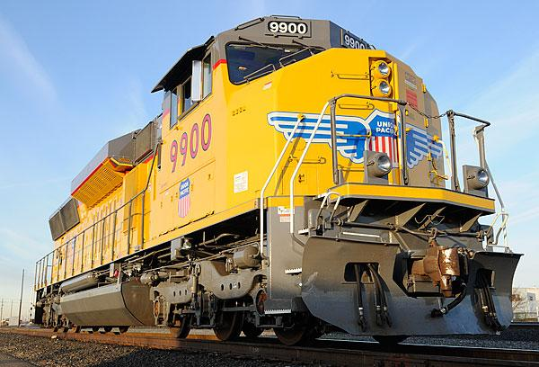
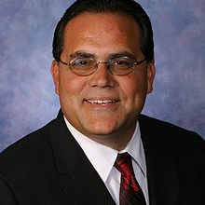

Professor Aguas
Career
Life Experiences
U.S. Army Reserve | Union Pacific Railroad | Financial Services | FCB Instructor Finance

Slide 4
Relocation, Relocation,
Relocation
1980 – 1984: Union Pacific Railroad (UPRR) Nampa, Idaho | 1996 – 1997: UPRR Pocatello, Idaho
1984 – 1986: UPRR Omaha, Nebraska | 1997 – 2002: American Presidential Lines (APL) Oakland, California
1986 – 1988: UPRR Salt Lake City, Utah | 2002 – 2005: Financial Services Phoenix, Arizona
1988 – 1989: UPRR Kansas City, Missouri | 2005 – Current: Financial Services Flagstaff, Arizona
1989 – 1990: UPRR Omaha, Nebraska | 2005 – 2022: Community Giveback: Coach HS Football Flagstaff, Arizona
1990 – 1996: UPRR Portland, Oregon | 2012 – Current: Northern Arizona University Flagstaff, Arizona

Slide 5

Considering Your Cash Flow
“Cash Inflows”

Slide 6

Think about it…
What do you think your salary will be in your first-year post graduation?
$0 to $50,000
$50,001 to $70,000
$70,001 to $100,000

Slide 7
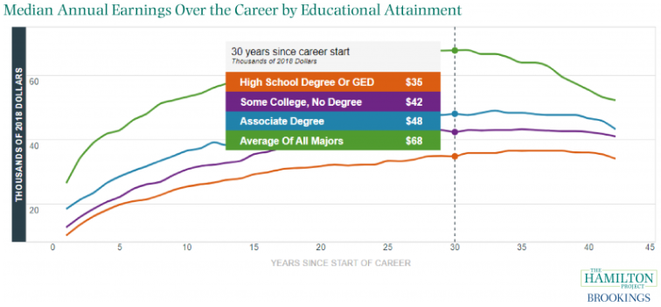
Answer
The correct answer is, it depends on your employment “Work Status”.

Slide 8
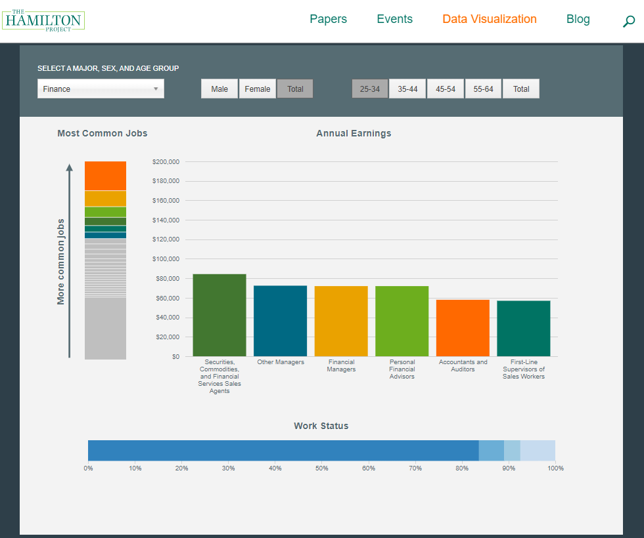
Annual Earnings for ages “25-34” year olds.
$84K
$72K
$72K
$72K
$58K
$57K

Slide 9
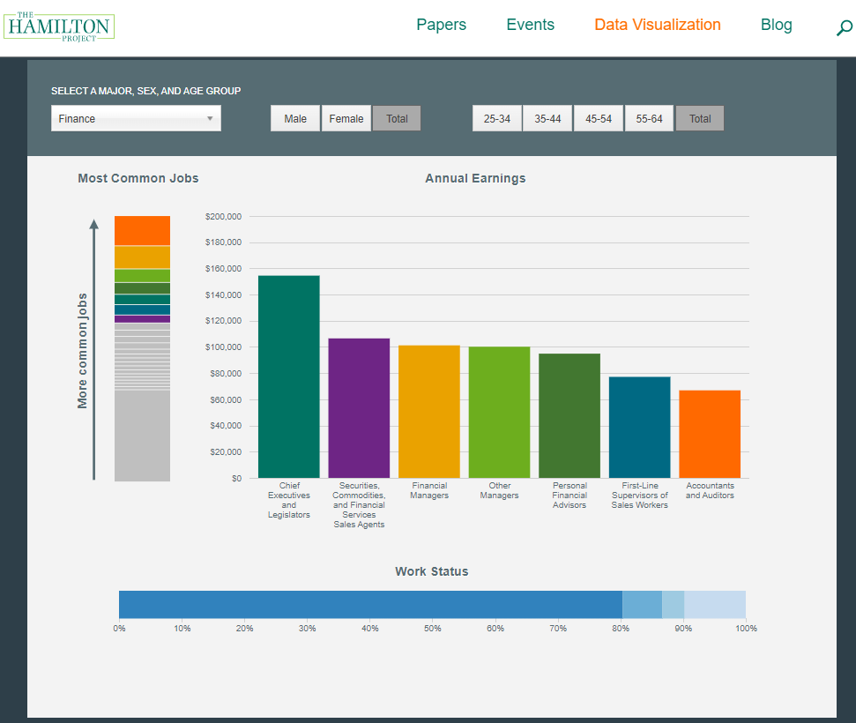
$154K
Annual Earnings for “all age” groups combined!
$106K
$100K
$100K
$95K
$77K
$67K

Slide 10
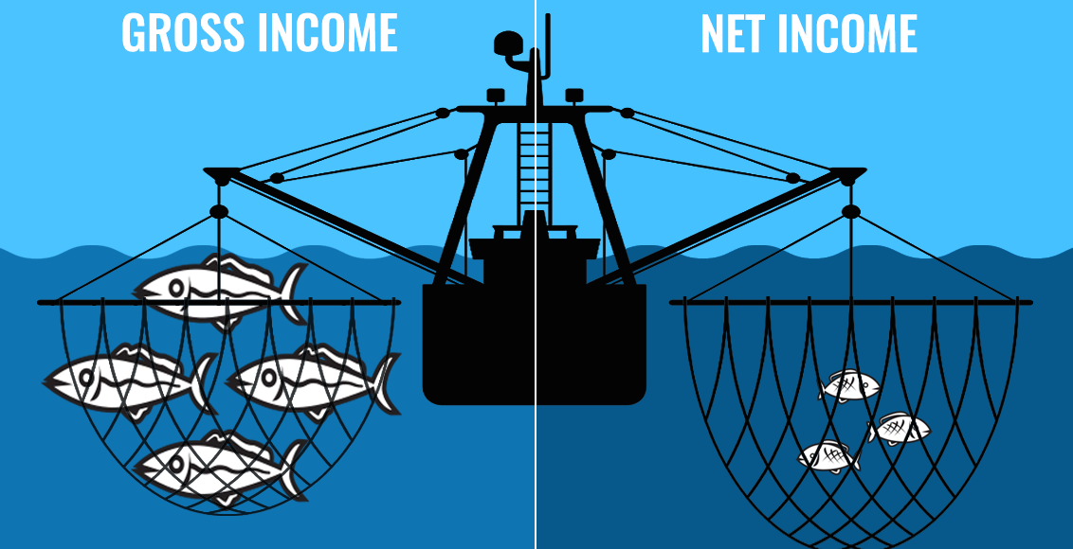
Gross vs. Net Income

Slide 11

Think about it…
If you’re making around $70,000 (gross/year) what would be your approximate net income after taxes?
$60,000
$70,000
$50,000

Slide 12
Answer
The correct answer is about $50,000
$70,000 Gross Income before Taxes
Less -$11,258 Federal Taxes
Less -$5,355 Social Security and Medicare (FICA)
Less -$2,450 State of Arizona Taxes
Equals = $19,063 Total Tax and FICA obligation
~$50,937 Net Income After Taxes and FICA

Slide 13
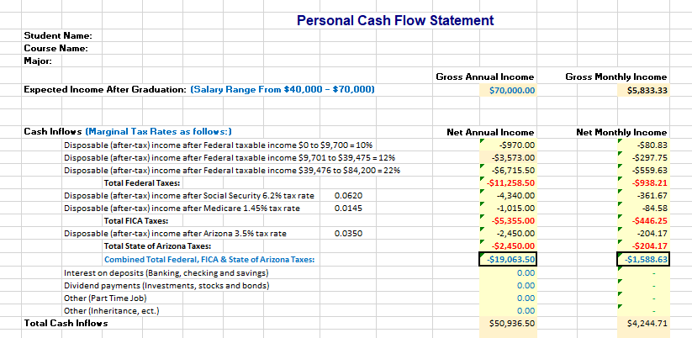

Slide 14

Considering Your Cash Flow
“Cash Outflows”

Slide 15
Think about it…
How many of the “cash outflows” line items are you currently supporting yourself?
¼ ½ ¾
All of them
None of them

Slide 16

Considering Your Cash Flow
“Spending Trade-offs”

Slide 17
Think about it…
When you look at the types of cash outflows, which do you have the most ownership and control over adjusting, or eliminating?
What does this mean for your personal spending habits?

Slide 18
Rent
Car Payment
Utilities
Groceries
Clothing
Recreation
Dining Out
Gym Memberships
Vacations
College Debt
Benefit Package
Credit Card

Slide 19
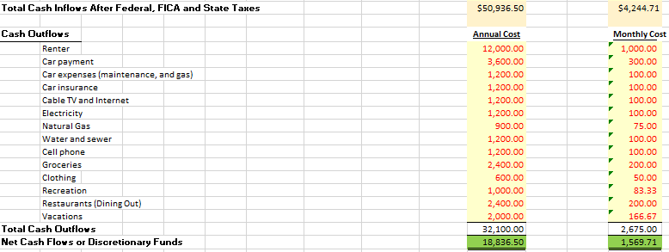


Slide 20
Considering Your Cash Flow
“College Debt”

Slide 21
Think about it…
Has anyone taken out student loans to help pay for your NAU education?
If so, do you know the terms of those loans? Yes / No

Slide 22

Do you know…
When must you start paying on your college loans?
What your monthly payment, per loan, will be?
The names and contact information for your loan servicers and/or how to access your loan account(s) online?
What some of the “Pros” and “Cons” of refinancing or consolidating your student loans away from the government are?

Slide 23
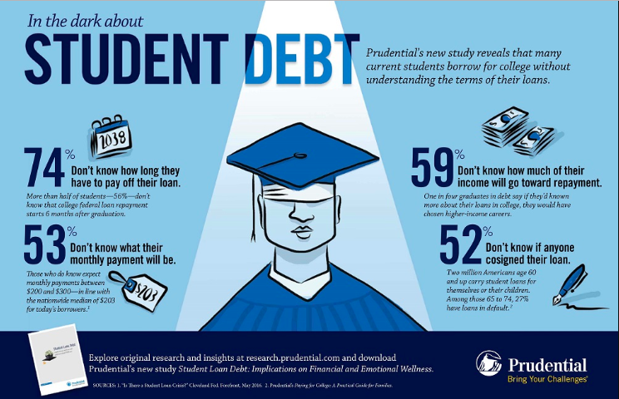

Slide 24
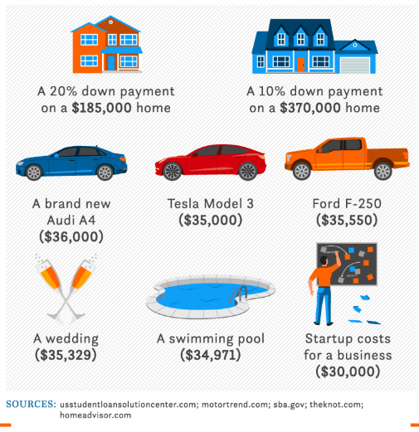
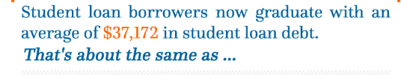
What the average college grad’s debt looks like…

Slide 25
College Debt Continued…
Student Loan Calculator
Loan amount: $37,172
Loan term in years: 10 years
< or >
Loan term in months: 120 payments
Interest rate per year: 3.7%
Monthly Payments: $371
Total Principal Paid: $37,172
Total Interest Paid: $7,348
Total Student Loan Cost: $44,520

Slide 26
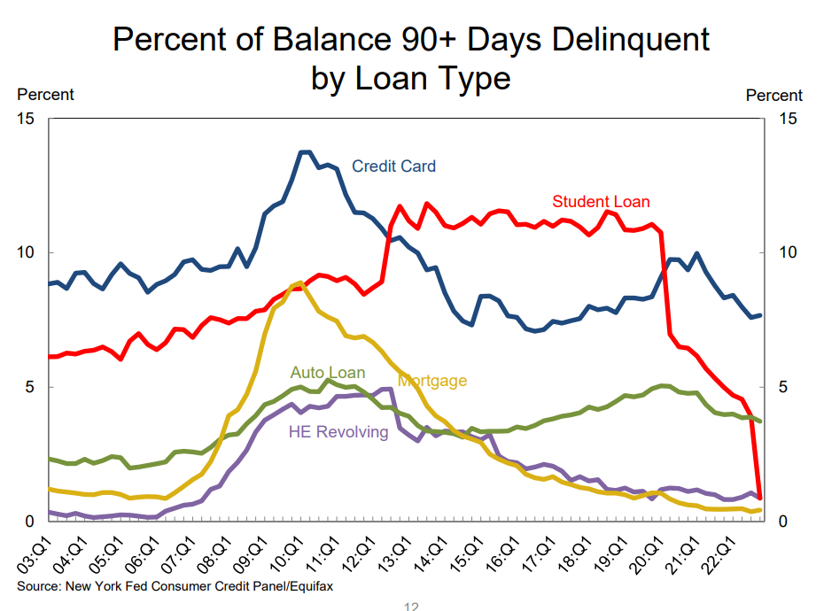

Slide 27
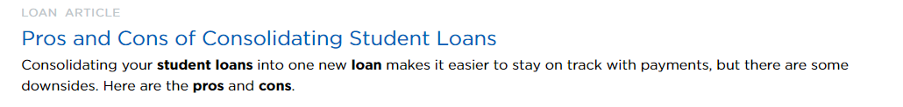
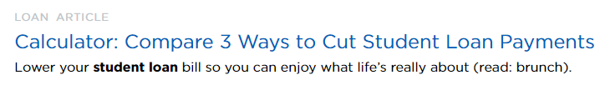
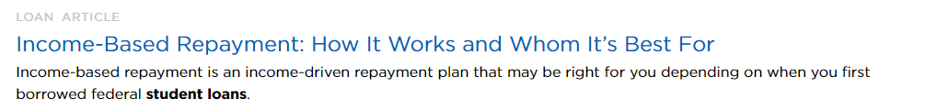
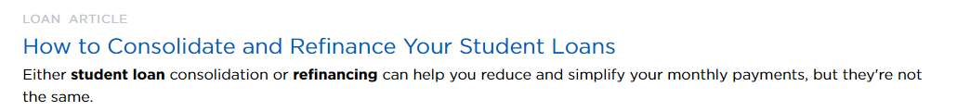
Knowledge is power!
Online resources like www.NerdWallet.com can help decode student loan repayment options. Do some research and become empowered to develop your own payment plan!

Slide 28
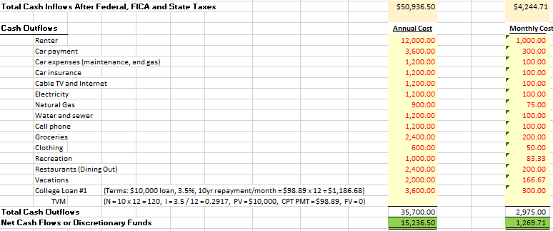

Slide 29

Considering Your Cash Flow
“Health Benefits”

Slide 30
Think about it…
What do you know about Corporate Healthcare Benefit packages?
Do you think it makes more sense to stay on your parents’ insurance plan until age 26, or move over to your new employer's plan?

Slide 31
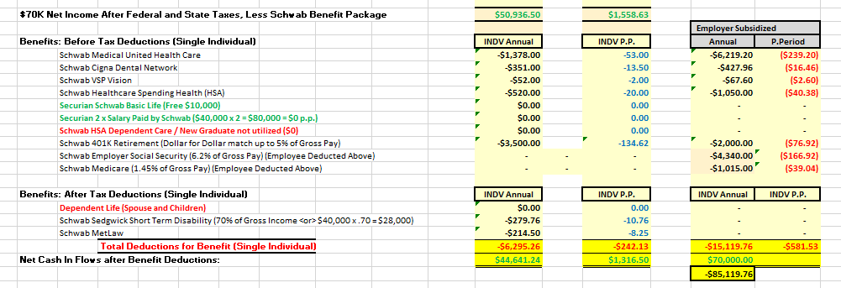

Slide 32
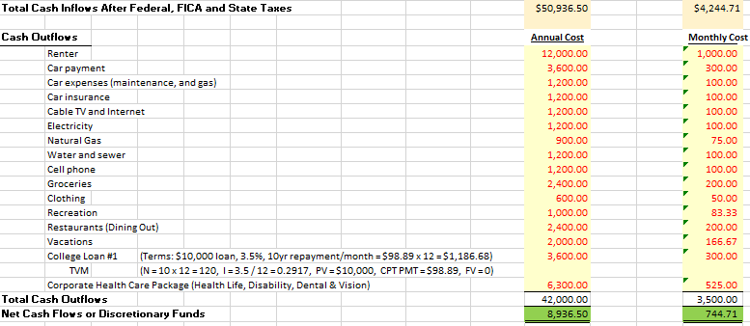

Slide 33
Considering Your Cash Flow
“Credit Card Debt”

Slide 34

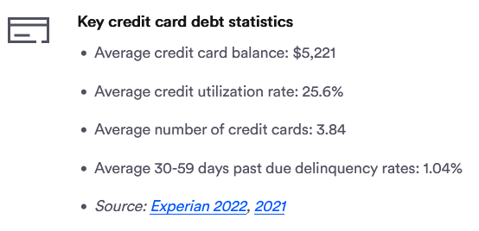
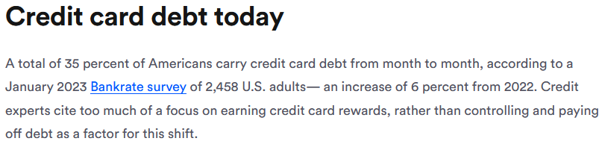

Slide 35
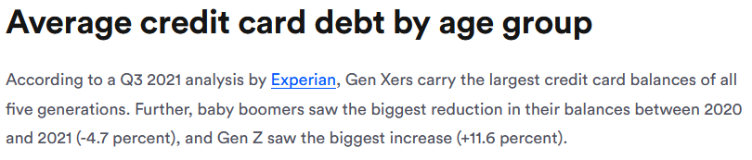
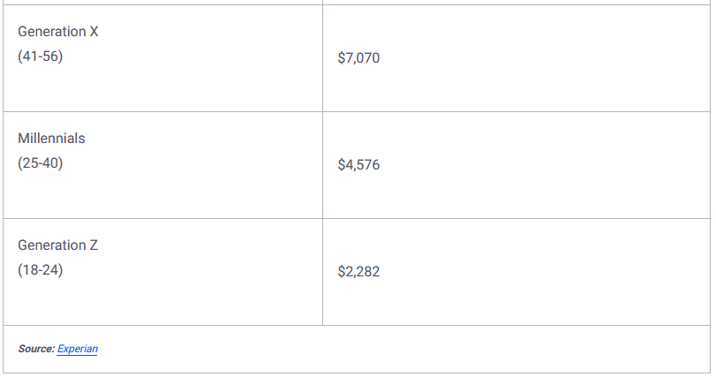

Slide 36
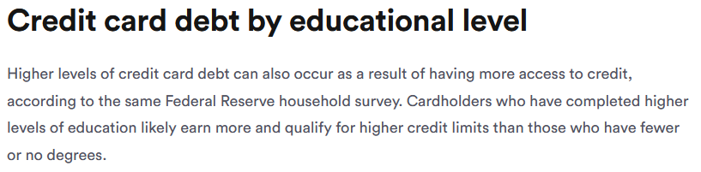
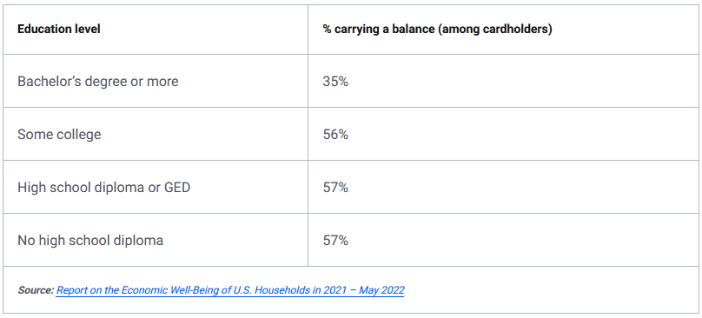

Slide 37
Think about it…
What is the average Credit Card balance for soon-to-be college graduates?
$1,000
$1,800
$2,500

Slide 38
Consider this…
Not all college students used credit cards responsibly.
Only 66 percent in 2015 reported paying their credit card bills in full each month.
Among soon-to-be college graduates who had a credit card in April 2016,
33 percent had made a late payment
31 percent had maxed out a card
25 percent said they sometimes charge purchases when they don’t have the money to pay for them and 15 percent said they frequently do.
~30 percent of grads-to-be carried credit card debt
The average balance was $2,573

Slide 39
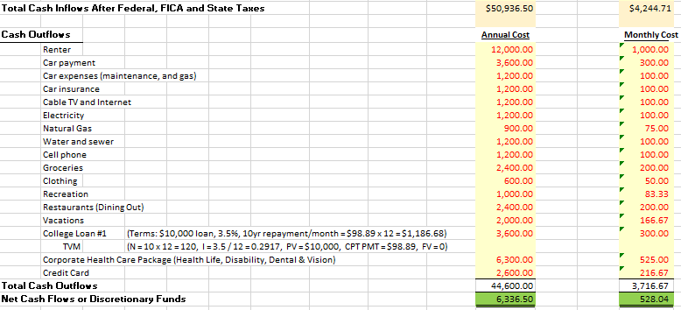

Slide 40
Considering Your Cashflow
“Debt Trade-offs”

Slide 41
What would you do?
With limited cash, in what order would you prioritize paying the following debts?
Student Loans
Car Payment
Rent
Credit Cards

Slide 42
What factors should you consider?
Prioritize according to interest rates
Prioritize according to size of debt
Refinance and consolidate debt to get lower rates
Prioritize corporate benefit packages, college debt, health care, wellness, retirement
If you have a high credit score, can you utilize it to refinance to get a better interest rate? (720 or higher is best)

Slide 43
Final Wisdom…
Make your own cash flow worksheet to understand where you’re at and where you can make adjustments.
Have conversations with your parents, loan servicers, new employer HR department and others to give yourself the information you need to make sound financial decisions. Check out websites like www.NerdWallet.com for more useful info, such as loan refinancing comparison and calculation tools & tips. Knowledge is power!
Pay attention to what different Employer Benefits Packages offer you in terms of healthcare, retirement, a student loan pay down option, wellness perks (gym, etc.) and consider opting to work for companies that work for you!

Slide 44
Final Wisdom…
4. Trade-offs matter. In your early years after college, put your limited earnings where they can work for your future:
  Begin to work on removing your college debt. Goal – try to pay off all college debt during your working years so you can be debt free at retirement
  Begin establishing your emergency fund (6mo x monthly expenses) For example: $2k/month x 6 = $12k emergency fund
  Work up to funding your 401k to the point that you max out your employer contribution (~5%)

Slide 45
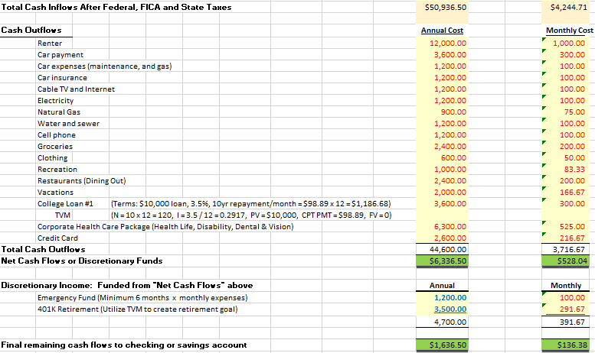

Slide 46

Thank You
Any other Questions?
Kevin.Aguas@nau.edu

