Slide 1

2025 Undergraduate Symposium
Friday, April 25, 2025

Slide 2

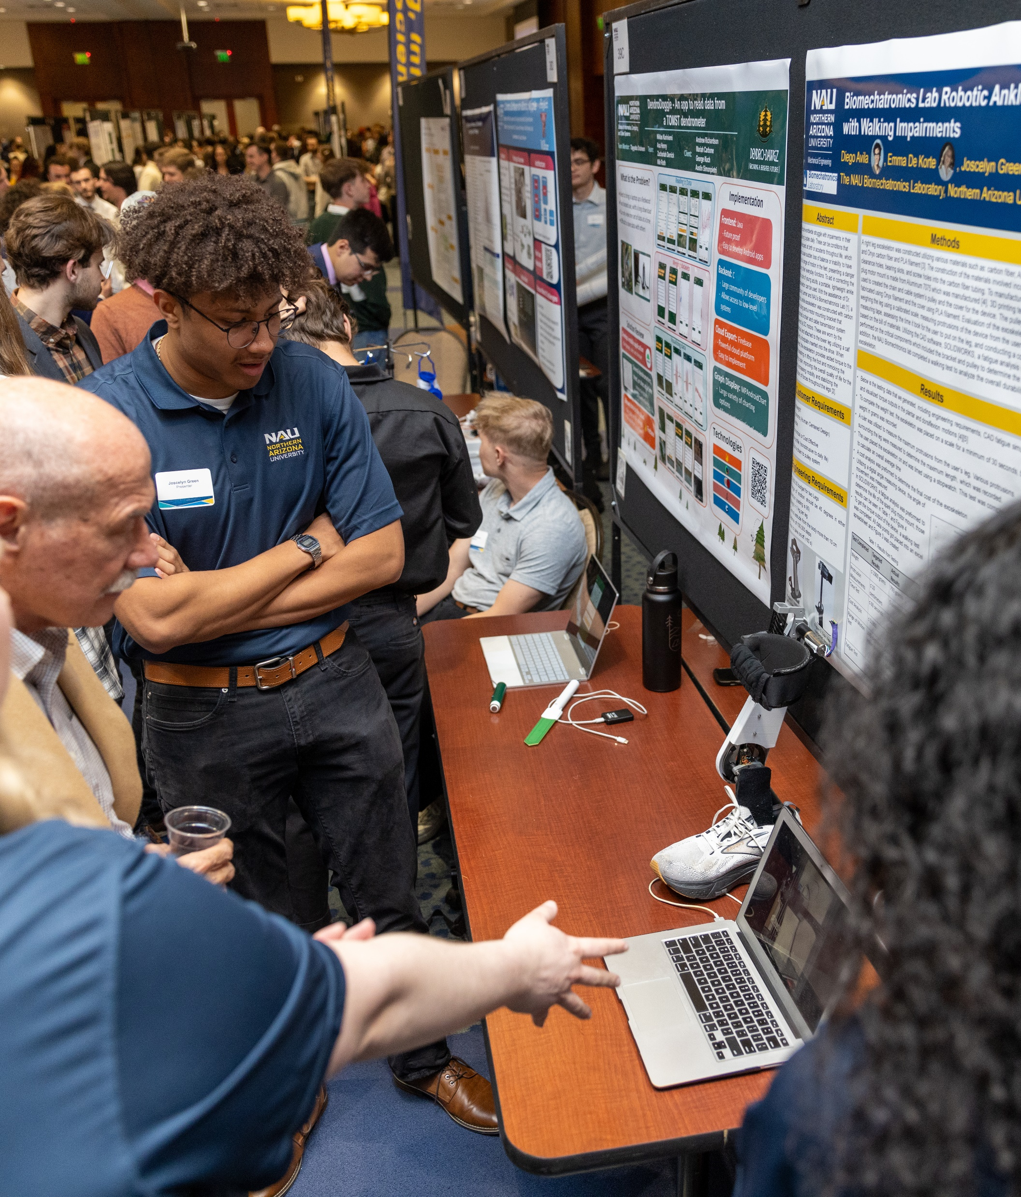
Why present?
1
For continued personal and professional development
Show off your hard work to members of the community, industry representatives, faculty, and other students
  You never know when you will make that valuable connection that could impact your future!
Gain new perspective on your work by getting feedback from others
Great addition to your resumé and talking point in interviews
2
3
4

Slide 3
Why attend?
Learn about exciting research taking place across all disciplines at NAU
Engage in thought-provoking conversations with researchers about their work
Get ideas for your own future projects or capstone
See what it takes to present, in case you have the opportunity to share your work at a conference someday
Support those who have worked hard all year to be able to showcase their research at the event

Slide 4

Important dates
Feb 1
Mar 21
Apr 25
Registration
Opens
Last day to register to present
Event day!
8:30 am – 4 pm
More information available at nau.edu/symposium

Slide 5

