Slide 1
Poster Design

Slide 2
“The more visually striking your presentation is, the more people will remember it. And more importantly, they will remember you.”
- Paul Arden

Slide 3
The Purpose of an Academic Poster
A means for displaying information in a clear, concise way while generating interest to engage in discussion

Slide 4
Workshop Goals
Learn the main components of a poster
Understand the elements of poster design
Design a rough draft storyboard

Slide 5

In a nutshell…
your poster must grab eyeballs.

Slide 6
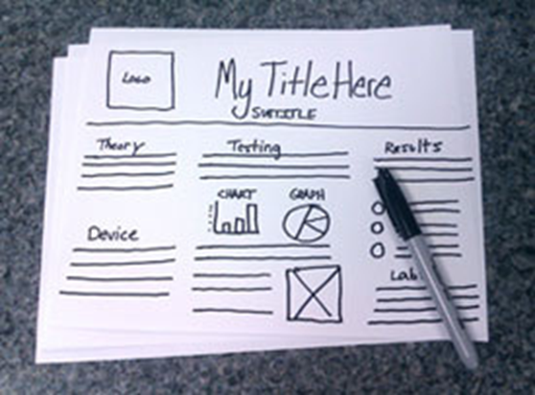
Preparing your poster
Consult conference rules and/or rubrics
Collaborate with your research mentor
Know your audience
Create a storyboard/plan
Use concise writing
Include transitions between sections when possible

Slide 7
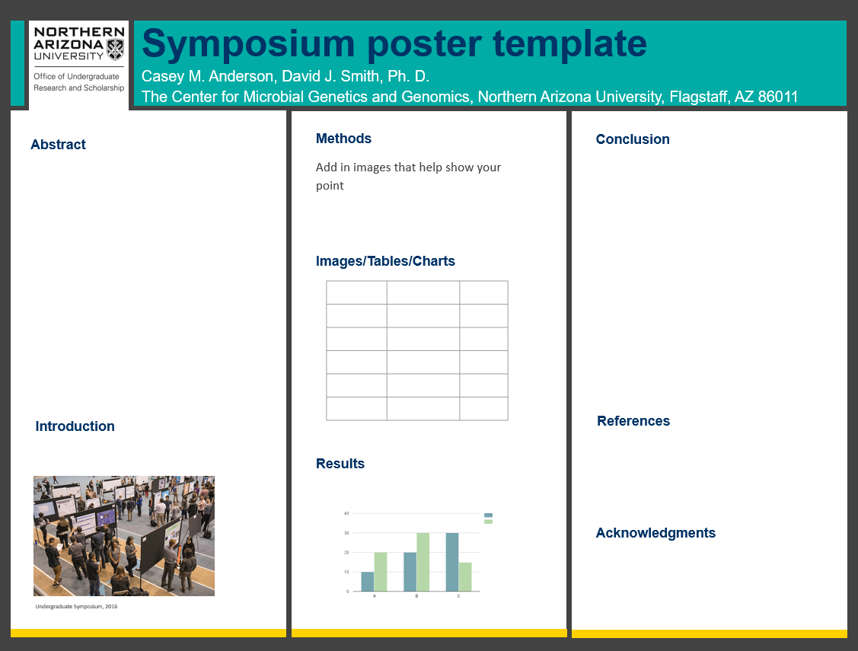
Main Elements of a Poster
Title
Names (First MI Last)
Logo
Department
University
Headings
Graphs,tables, and/or images

Slide 8
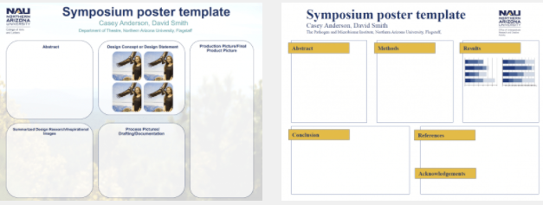
Poster Templates and Tips
Poster templates and tips available here:
https://nau.edu/undergraduate-research/presentation-information/

Slide 9
Title
Be descriptive
Use simple word combinations
Avoid abbreviations and acronyms
Write scientific names in full
Avoid use of Roman numerals

Slide 10
Authors, Affiliations, Etc.
Beneath the title, list:
Name(s) of the student author(s)
Faculty sponsor(s)
Department/school
Include the NAU logo
  https://nau.edu/university-marketing/marketing-resources/official-logos/

Slide 11

Poster Headings
Abstract (summary of presentation)
Introduction
Methods
Results
Conclusion/Discussion
References
Acknowledgements

Slide 12
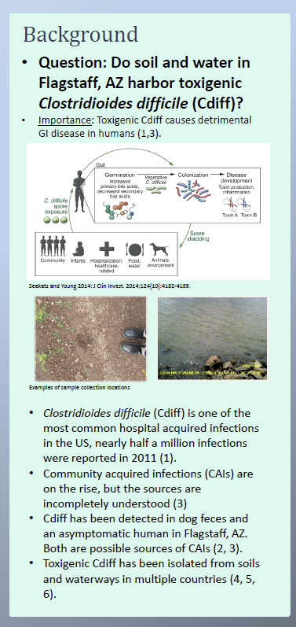
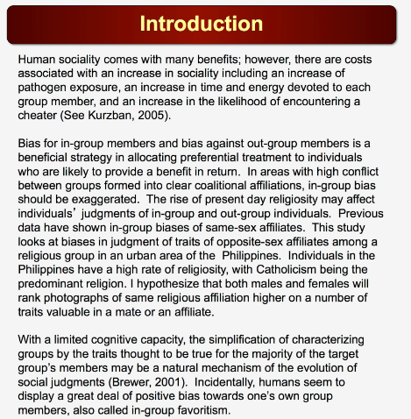
Introduction
Clearly state the problem or concept being investigated or demonstrated
Include the significance of the study – why should we care about this topic?
Include related current investigations and foundation for your work
Usually contains citations and references
May have purpose and hypothesis embedded
Get viewers interested!

Slide 13
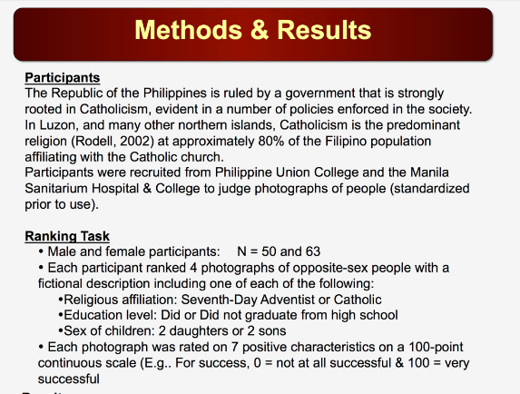
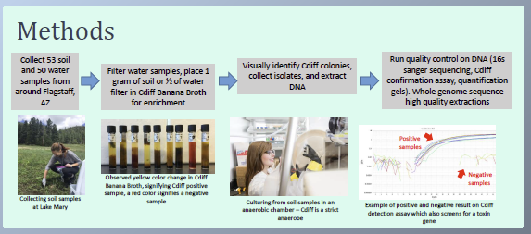
Methods
Describe procedures in detail to allow observer to understand how, when, and where data was obtained
Include text with subheadings to group content
Include (if relevant):
  Subjects
  Experimental design
  Equipment used
  Statistical methods
  Why you chose the method
May include a flow chart to help flow
May include citations
Describe challenges

Slide 14
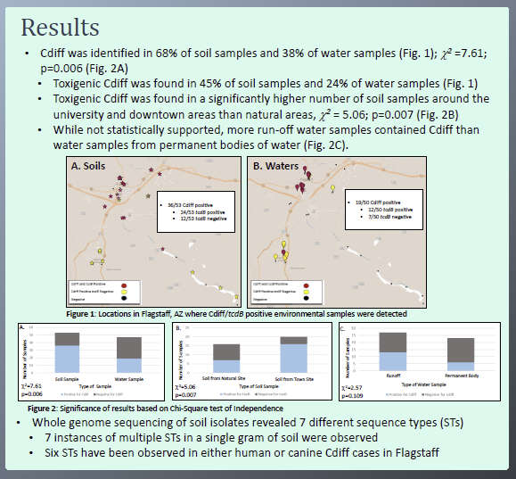
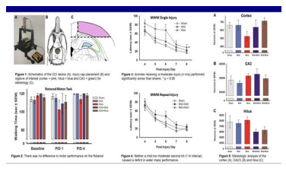
Results
Summarize data and reports findings
Make image-based when possible – maximize use of figures
  Keep simple, easy to see, text large enough
Don’t present raw data
Minimize use of tables
Often the largest section

Slide 15
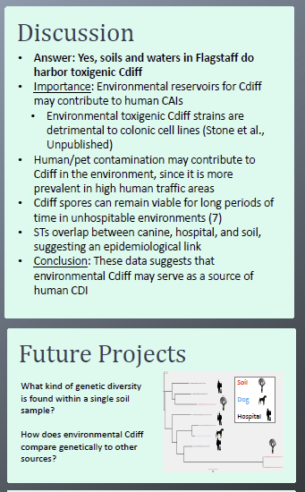
Conclusion/Discussion
Interpret the meaning or implications of your results
Mention alternative explanation for results
Tie back to a real-world problem
Communicate why this is important
Bulleted points work well

Slide 16
Poster Content
Put your research in context
Should be readable by a non-technical, educated audience
Edit your poster carefully for typographic or grammatical errors and image quality
Generally more graphics & less text is preferred
No more than 800 words
Avoid technical jargon
Acknowledge all sources of funding

Slide 17
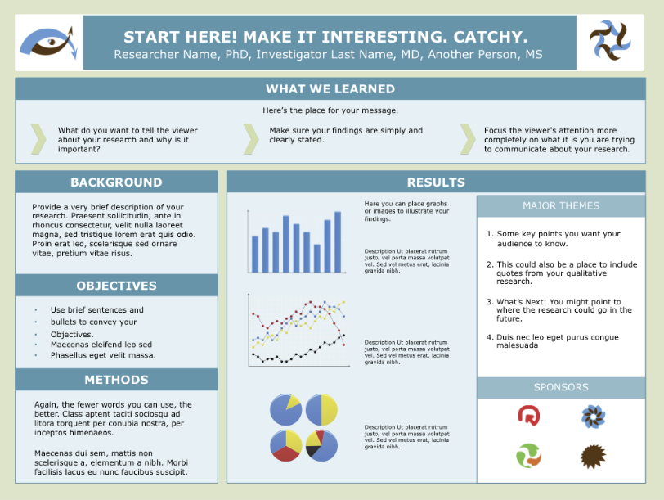
Alternative Examples

Slide 18
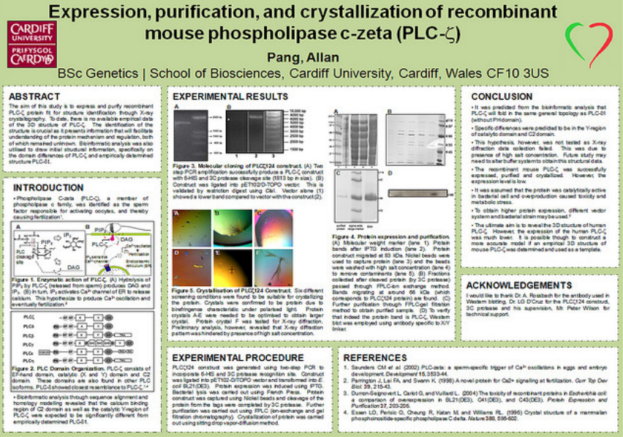
Poster Appearance
Make poster visually appealing
  Balance text and images
Make an obvious flow
Should be “stand alone” display
Use pictures and graphs to convey your results
Use white space or color frames to organize sections

Slide 19
Poster Appearance
Don’t cram in too much information
Unobtrusive or neutral background; avoid using dark, solid color backgrounds
Use high resolution images
Create the poster the size you need in PowerPoint or PDF
(In PowerPoint, select Design –> Slide Size)
Cramming too much information into too small of a space is the most common mistake in academic poster design

Slide 20
Poster Appearance
Use traditional fonts (Arial, Times New Roman, Garamond)
Don’t use more than two or three fonts
Use italics or bold for emphasis, not for all your text
Avoid ALL CAPS
Item | Font Size (points) | Comments
Title | 150+ | Should be visible from across a room!
Headings | 32+ | Should be easily readable from 5 feet away
Subheadings | 20+ | This text is smaller than headings, but more noticeable than main text size
Main Body Text | 16-18 | This is a comfortable text size for someone who comes closer to read more
Captions | 12-16 | These can be a bit smaller than main text

Slide 21
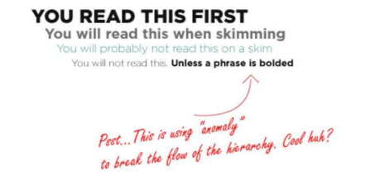
Visual Hierarchy
  A person will scan your poster in less than 10 seconds to decide if they want to learn more
We tend to focus on differences, not similarities

Slide 22
Poster Tour
Layout
Colors
Fonts
Headings
Spacing
Graphics

Slide 23
Final Tips
Make poster clearly laid out and easy to follow in absence of a presenter
Don’t cram too much into too small a space or use too small of font
Include labels for figures and tables
Use photographs, tables, and graphs that improve understanding and enhance the visual appeal
Double check it (and have someone else check it) before you print
Check online for samples and ideas

Slide 24
Important Dates
Register to present: Feb 1 – Mar 15
Poster Design and Editing Open Houses:
  April 3, 1-5 pm
  April 9, 2-6 pm
Deadline to upload PDF of poster and/or video: April 19
Undergraduate Research Symposium: Friday, April 26
  Register at nau.edu/symposium

Slide 25
Good luck with your posters!
More information available at nau.edu/symposium

